Slide 1
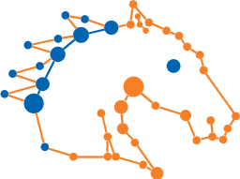



Maverick: Discovering Exceptional Facts from Knowledge Graphs
Gensheng Zhang, Damian Jimenez, Chengkai Li
SIGMOD, Houston, June 14, 2018
idir.uta.edu

Slide 2

Exceptional Facts
Denzel Washington followed Sidney Poitier as only the second black to win the Best Actor award.
Entity of interest
Denzel Washington
Context
Best Actor award winners
Attributes
Ethnicity
Peculiar value
African American
(only two satisfy)
idir.uta.edu

Slide 3
Exceptional Facts
Denzel Washington followed Sidney Poitier as only the second black to win the Best Actor award.
Entity of interest
Denzel Washington
Given an entity x
find
Context
Best Actor award winners
A context
Attributes
Ethnicity
A set of attributes
(subspace)
Peculiar value
African American
(only two satisfy)
idir.uta.edu

Slide 4
Exceptional Facts
Denzel Washington followed Sidney Poitier as only the second black to win the Best Actor award.
Entity of interest
Denzel Washington
Given an entity x
find
such that
Context
Best Actor award winners
A context
the context has many entities, including x
Attributes
Ethnicity
A set of attributes
(subspace)
Peculiar value
African American
(only two satisfy)
x bears a peculiar value w.r.t. the subspace (few in the context have the value)

Slide 5

Exceptional Facts
Denzel Washington followed Sidney Poitier as only the second black to win the Best Actor award.
This was Brazil's first own goal in World Cup history.
Hillary Clinton becomes first female presidential nominee.
idir.uta.edu

Slide 6
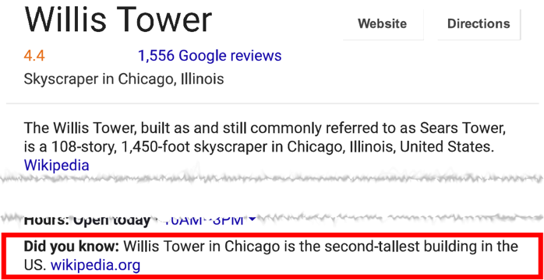
Applications
Computational Journalism
Fact-finding
Fact-checking
The first female presidential nominee was Victoria Woodhull, not Hillary Clinton (snopes.com)
Data Cleaning
Recommendation Systems
Friends, news, and product promotion
idir.uta.edu

Slide 7
Exceptional Facts from Knowledge Graphs
What is exceptional about G1?
G3
G1
S3
scored-by
scored-by
awarded-to
awarded-to
S1
play-for
G5
awarded-to
CRO
play-for
scored-by
BRA
play-for
play-for
S5
ESP
awarded-to
play-for
awarded-to
S4
G4
S2
G2
scored-by
scored-by
idir.uta.edu

Slide 8
Modeling
Attributes: labels of incoming/outgoing edges
Subspace: a subset of attributes
G1. awarded-to = CRO
G3
G1
S3
scored-by
scored-by
awarded-to
awarded-to
S1
play-for
G5
awarded-to
CRO
play-for
scored-by
BRA
play-for
play-for
S5
ESP
awarded-to
play-for
awarded-to
S4
G4
S2
G2
scored-by
scored-by
idir.uta.edu

Slide 9
Modeling
Context: entities sharing some common characteristics
Defined by a pattern-variable pair
?g
?s
BRA
Goals scored by Brazilian players
awarded-to
play-for
idir.uta.edu

Slide 10
Modeling
Context: entities sharing some common characteristics
Defined by a pattern-variable pair
?g
?s
BRA
Goals scored by Brazilian players
awarded-to
play-for
G3
G1
S3
scored-by
scored-by
awarded-to
awarded-to
S1
play-for
G5
awarded-to
CRO
play-for
scored-by
BRA
play-for
play-for
S5
ESP
awarded-to
play-for
S4
G4
S2
awarded-to
G2
scored-by
scored-by
idir.uta.edu

Slide 11
Modeling
Context: entities sharing some common characteristics
Defined by a pattern-variable pair
?g
?s
BRA
Goals scored by Brazilian players
awarded-to
play-for
G3
G1
S3
scored-by
scored-by
awarded-to
awarded-to
S1
play-for
G5
awarded-to
CRO
play-for
scored-by
BRA
play-for
play-for
S5
ESP
awarded-to
play-for
S4
G4
S2
awarded-to
G2
scored-by
scored-by
idir.uta.edu

Slide 12
Modeling
What is exceptional about G1?
Among all the goals scored by BRA players, G1 is the only own goal.
G3
G1
S3
scored-by
scored-by
awarded-to
awarded-to
S1
play-for
G5
awarded-to
CRO
play-for
scored-by
BRA
play-for
play-for
S5
ESP
awarded-to
play-for
S4
G4
S2
awarded-to
G2
scored-by
scored-by
idir.uta.edu

Slide 13
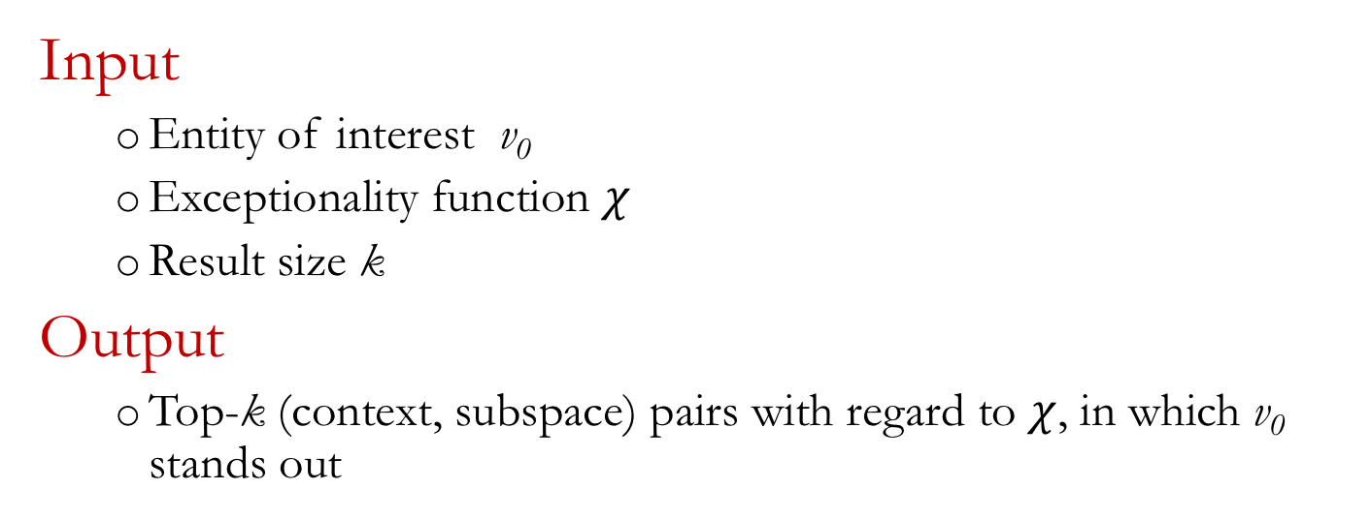
Problem Formulation
Input
Entity of interest v₀
Exceptionality function $χ$
Result size k
Output
Top-k (context, subspace) pairs with regard to $χ$, in which v₀ stands out
idir.uta.edu

Slide 14
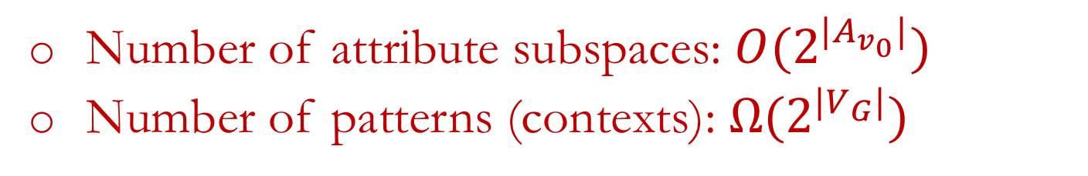
Challenges
Number of attribute subspaces: $O(2^{|A_{v_{0}}|})$
Number of patterns (contexts): $Ω(2^{|V_{G}|})$
{}
?g
{scored-by}
{awarded-to}
{match}
?g
awarded-to
?t
?g
scored-by
?s
?g
awarded-to
CRO
?g
scored-by
S1
{scored-by,
awarded-to}
{scored-by,
match}
{awarded-to,
match}
?g
awarded-to
?t
play-for
?s
?g
awarded-to
?s
play-for
?t
?g
awarded-to
?t
play-for
S2
?g
awarded-to
?s
play-for
BRA
{scored-by, awarded-to,
match}
CRO
?t
?g
awarded-to
play-for
?s
?g
awarded-to
S1
play-for

Slide 15
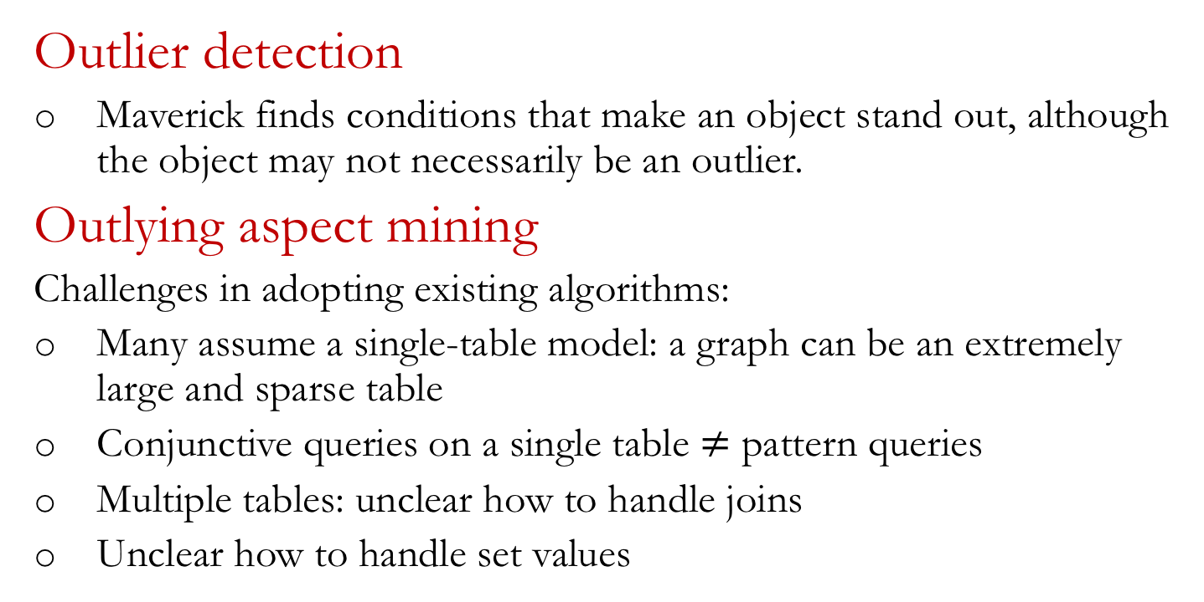
Related Work
Outlier detection
Maverick finds conditions that make an object stand out, although the object may not necessarily be an outlier.
Outlying aspect mining
Challenges in adopting existing algorithms:
Many assume a single-table model: a graph can be an extremely large and sparse table
Conjunctive queries on a single table $≠$ pattern queries
Multiple tables: unclear how to handle joins
Unclear how to handle set values
idir.uta.edu

Slide 16
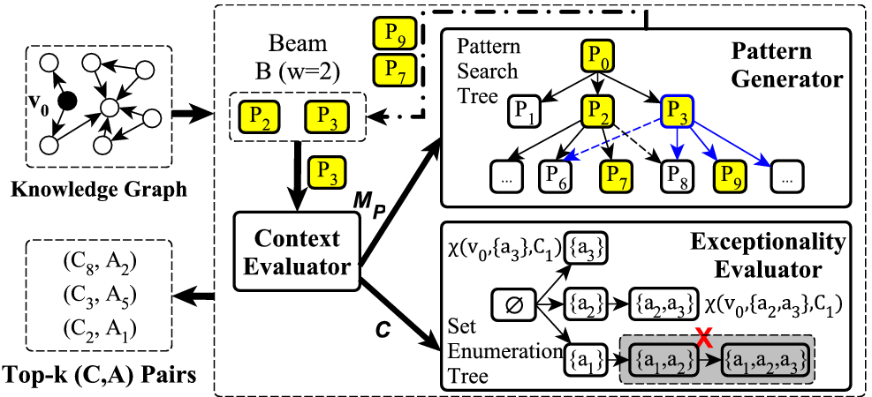
Maverick

Slide 17



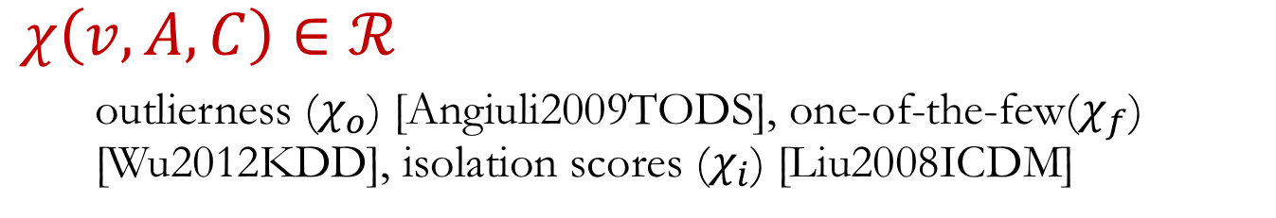
Exceptionality Function $χ$
$$χ\left(v, A, C\right)∈ℛ$$
outlierness ($χ_{o}$) [Angiuli2009TODS], one-of-the-few($χ_{f}$) [Wu2012KDD], isolation scores ($χ_{i}$) [Liu2008ICDM]
Upper bound function
Theorem 4.2
Theorem 4.3
Theorem 4.4

Slide 18
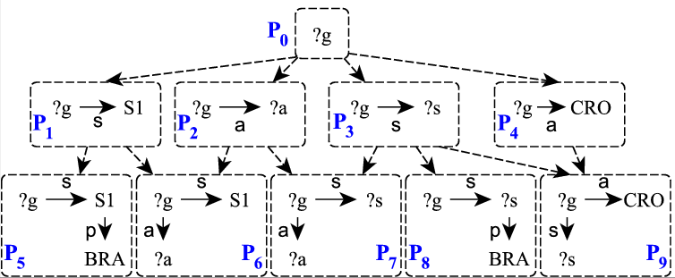
Pattern Generator (PG)

Slide 19
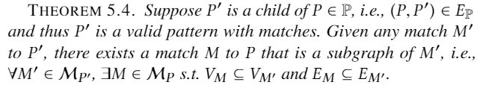
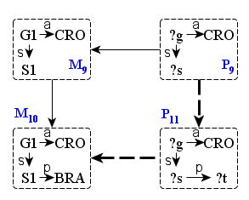
Match–based Pattern Generation
Construct Partial Order of Valid Patterns
idir.uta.edu

Slide 20
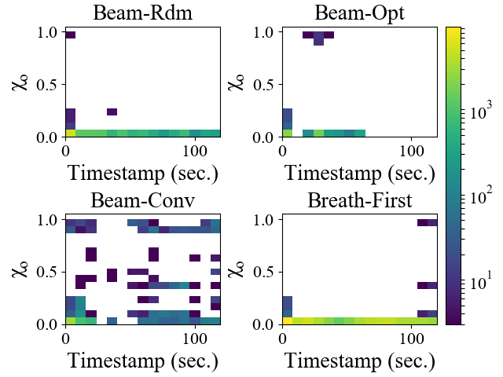
Datasets and Experiments
WCGoals
Created based on FIFA.com
11 node types, 13 edge types
49,078 nodes, 158,114 edges
Film-Award
A subgraph of Freebase
95 node types, 117 edge types
5,437,628 nodes, 10,879,448 edges

Slide 21
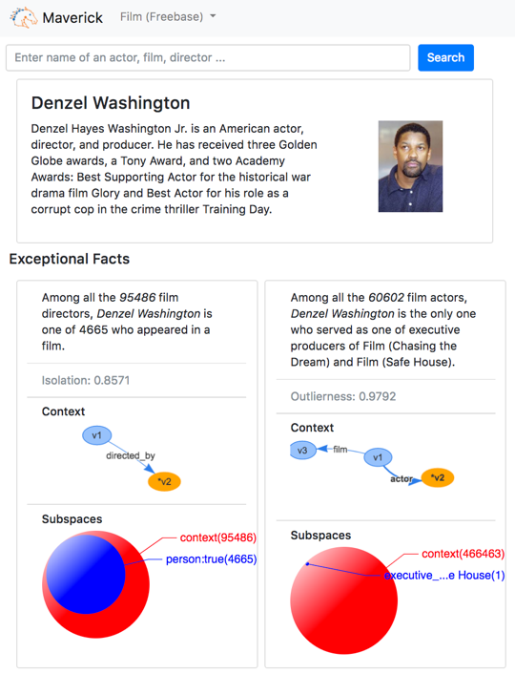
See you in Rio
VLDB2018 demo
Maverick: A System for Discovering Exceptional Facts from Knowledge Graphs
idir.uta.edu

